Slide 1
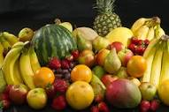
Healthy Eating
Aarushi Pujeri
16th April

Slide 2
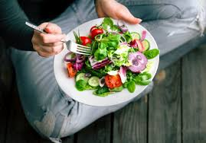
Intoduction on healthy eating
We need food to stay alive.
Food gives us energy to work and
play.It helps in growth and develo-
pment of our body.
Food helps our body to fight diseases.It makes us stronge and keeps us healthy.Children who do not get the right kind of food fall ill frequently.
In order to stay healthy we need to have a balanced meal.Our meal should contain food items from all the four food group.
The four food groups are-carbohydrates,proteins,vitamins-minerals and fats

Slide 3
Type of food based on nutrition value
Corbohydrates
Minirals
Vitamins
Proteins
Fats

Slide 4
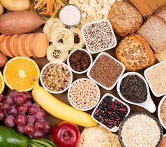
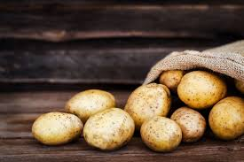
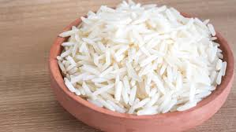
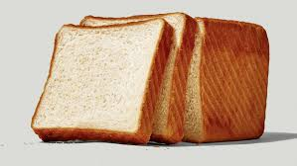
Carbohydrates
Carbohydrates are your body’s main source of energy. They come formStarch and sugar.
Food rich in carbohydrates are bread,cereals,paste,corn,beans,peas and potatoes
What is a Carbohydrates

Slide 5
Minerals
Minerals:Your body needs small amouts of minerals for good health.
Calcium
Potassium
Iorn
Iodine
Manganese
Copper
phosphorus

Slide 6
Minarals: calcium
Calcium is minaral that is nessesary for life. In addition to building bones and keeping them healthy calcium enables our blood to clot,our musuls to contract and our heart to beat,
99% off the calcium in our bodies is in our bones and teeths
Every day we loss our calcium through our skin,nails ,hairs,urine and faces
Our bodies can not produce its own calcium. that’s why it’s important to get enough calcium from the food we eat.
When we dont get calcium our body need it is taken from our bones. This is fine once in while but if it happens too often bones get weak and easier to break.

Slide 7
How much calcium required per day
1,000 milligrams (mg) a day for women ages 50 and younger
1,200 mg for women over 50

Slide 8
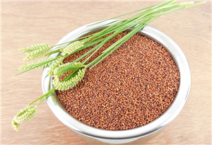
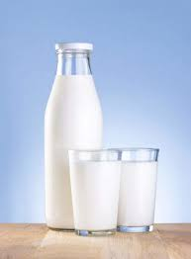
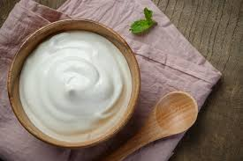
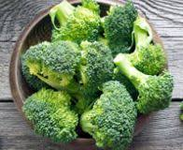
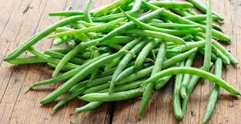
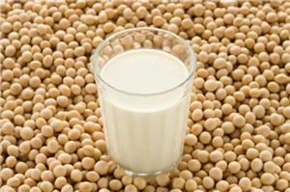
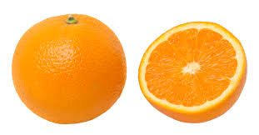
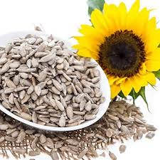
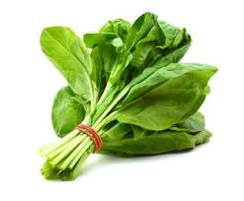
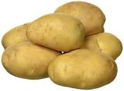
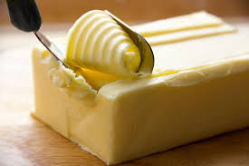
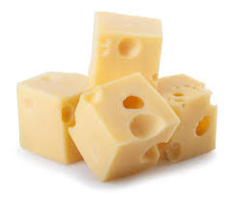
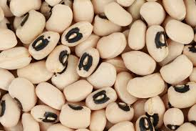
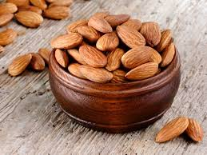
Foods with Calcium
Dairy products | Vegitables and fruits | Seeds

Slide 9
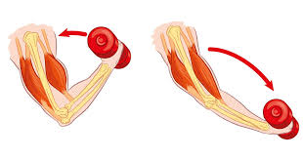
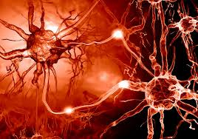
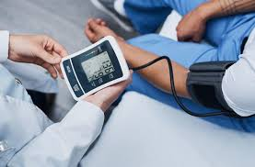
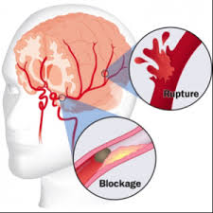
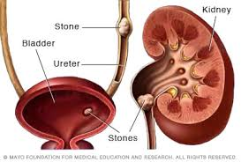
Minerals: why we need potasium
It helps regulate fuild balance
musules contraction
nerve signal
help reduce blood pressure
water retention
Protect against stroke
prevent osteoporosis and kidney stones

Slide 10
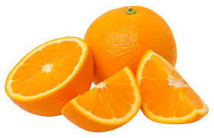
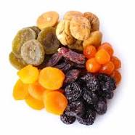
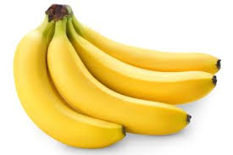
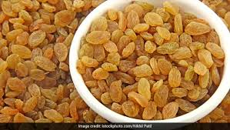
Rich in potasium
* banana
*oranges
*dry fruits
*raisiins

Slide 11
Minarals: Iron
Iron is a mineral vital to proper function of
hemoglobin,a protein in needed to transport
oxgyen in the blood.Iron also has a role in a
variey of other important processes in the
body.

Slide 12
Minarals: iodine
Iodine is a mineral found in some foods.The day needs iodine to make thyroid hormones. These hormones control the body’s metabolism and many other important functions.The body also needs thyroid hormones for proper bone.
The brain delepment during pregnancy and infancy.
Getting enough iodine
is important for everyone especially
infants and women who are pregnant.

Slide 13
How much iodine I need
The amount of iodine you need each day depends on your age
* Birth to 6 mouths 110 mcg
* infants 7-12 mouths 130 mcg
*Children 1-8 years 90 mcg
*Children 9-13 years 120 mcg
*Teens 14-18 years 150 mcg
*Adults 150 mcg
*Pregnant teens and women 220 mcg
*Breastfeeding teens and women 290 mcg

Slide 14
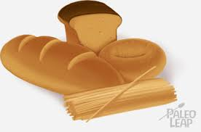
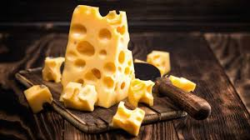

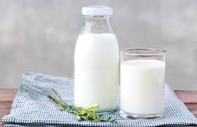
Rich in iodine
Daily producks
Producks made from grains

Slide 15
Manganese
Manganese is a trace mineral,Which your body
needs in small amounts.It’s required for the normal functioning of your brain,nervous systems and many of your body’s enzyme systems.
While your body stores up to 20 mg of manganese in
your kindneys,liver,pancreas and bones,also need to get to get it from your diet.

Slide 16
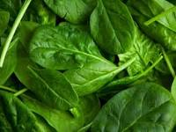
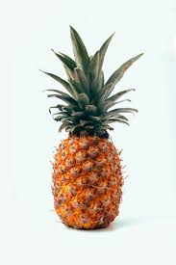
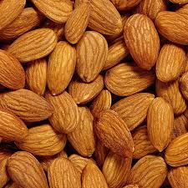
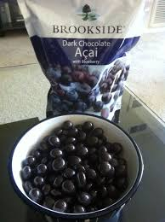
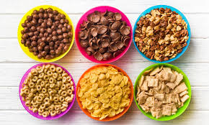
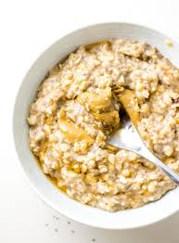
Rich in Manganese
leafy Greens vegetables such as spinach
Friuts such as pineapple and acai dark chocolate
nuts,such as almunds and pecons beans
oatmeat and bran cereals,Wole bread,Weat

Slide 17

Copper
Copper is an essential trace mineral necessary
for survival.It is found in all body tissuse and play a role in making red blood cells and the maintaining nerve cells and the immune system.

Slide 18
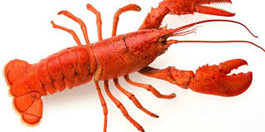
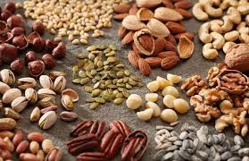
Rich in copper
Nuts and seeds
Lobster
Leafy Green vegetables
Dark chcocolate

Slide 19
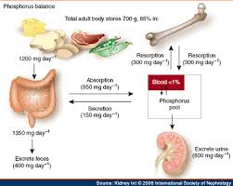
phosphorus
Phosphorus is a mineral that makes up 1% of person’s total body weight.It is the second most abundant mineral in the body.It is present in every cell of the body.Most of the phosphorus in the body is found in the bones and teeth.

Slide 20
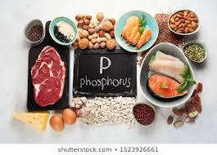
Rich in phosphorus
Chicken and turkey
Organ Meats
Seafood
Dairy producks
Sunflower and pumpkin seeds
Nuts Whole
Grains

Slide 21
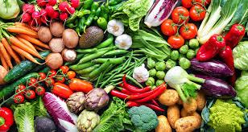
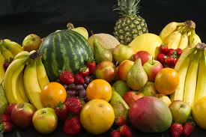
Vitmins
Vitmins:Your body needs small amounts of vitamins by eating a wide veriety of foods like fruits and vegetables along with your pizza and ice-cream.
Vitmins protect our body from several diseases. The fruits and vegetables will protect us from these diseases like cold and cough.

Slide 22
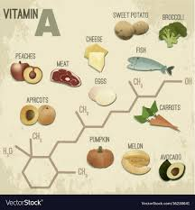
Vitmin A
Vitmin A is a group of unsaturated nutritional organic conpounds that icludes
retinol,retials,retinoic aicd,and several provitamin A carotenoide (most notably
beta-carotene) Vitmin A has multiple function: It is important for grouth and
development, for the maintenance of the immune systeem, and for good vision

Slide 23
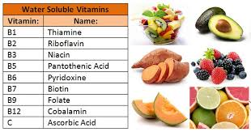
Vitmin B
B Vitmins are class of water-soluble vitmins that play important roles in cell metabolism. Though these vitmin share similar names,
they are chemically distinct conpounds that often coexist in the same food.

Slide 24
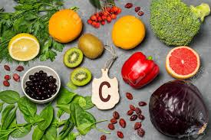
Vitmin C
Vitmin C is a water-soluble vitmin that’s found in some foods particularly friuts and vegetables.

Slide 25
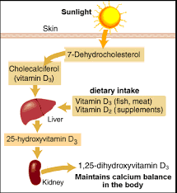
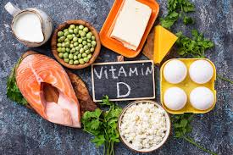
Vitmin D
Vitmin D is a nutrient found in some foods that is need for health.We get Vitmin D from sunlight.

Slide 26
Vitmin E
Vitmin E is found naturally is some foods,added other,and available as a dietary supplemend
“Vitmin E” is the collective name for a group of
fat-soluble.

Slide 27
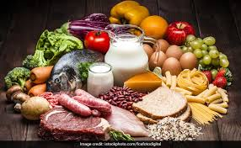



Proteins
Proteins build and repair body
tissues from hair and fingernails to
your muscles.
They help your body in fighting infections and
maintaing a healthy growth.
  They also help in buliding and repairing the wear and tear of the body.

Slide 28






Fats
Fats are important soures of energy.
They help in healthy skin.
Fats play an important role in your proper growth and develop
Ment.
They help in keeping your inteternal organs safe.

Slide 29

Food pyramid
Follow this food pyramid to enjoy
a balanced meal
Balanced Diet

Slide 30


Thank You

